Slide 1

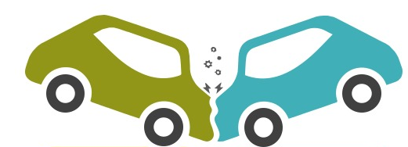
ROAD INJURIES IN CALIFORNIA
An Exploratory analysis using BI tools

Slide 2
TEAM 07
01
02
03
04
NIMEESHA VAKACHARLA
SINDHURA PANDRANGI
KALYANI ZOPE
SNEHA KARRI

Slide 3
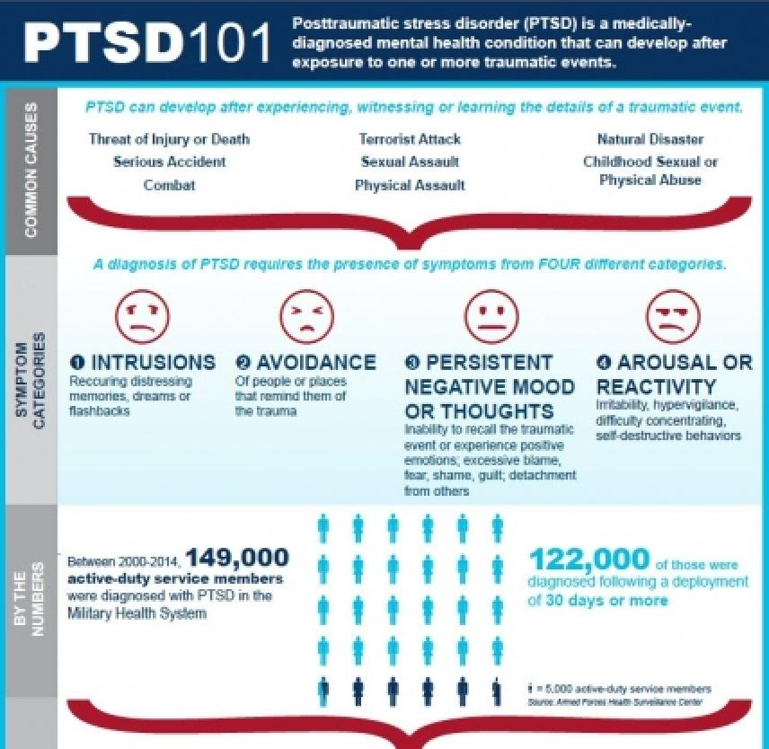
Reference: Armed Forces Health Surveillance Center. (n.d.). PTSD101. https://www.brainline.org/sites/default/files/What%20Is%20PTSD.pdf

Slide 4
01
BUSINESS PROBLEM
Basic Aim of the project

Slide 5
BUSINESS PROBLEM!
Every year, California is rocked by more road accidents compared to other states in the US. The main aim of the project is to :
Reduce number of accidents
Consequently have fewer casualities
Fewer economic losses
Exploratory analysis is performed on archivial data to identify trends, patterns and causes to plan further steps towards prevention.

Slide 6
BUSINESS QUESTIONS
02
Focus on the decision-making aspect

Slide 7


BUSINESS QUESTIONS!
1. Mode of transport
What are the types of transport most common in road accident occurrence?
2. Day vs Night
During which time of the day more causalities occur?
3. Which counties have most fatalities?
Among all the counties of California, which have most fatalities?

Slide 8
BUSINESS QUESTIONS!
4. Causalities vs deaths
In state of California, what is the death vs causalities comparison in road accidents?
5. Trend over years
What is the annual trend in causalities?
6. Population vs Injuries
What is the relationship between the number of injuries caused by accidents and population in providences?

Slide 9
DATA CLEANING & SQL CONNECTION Birds eye view of road accidents dataset
03

Slide 10
Aerial view of dataset
Road injuries in California dataset is a vast data giving information related to the injuries caused during road accidents in state of California.
It includes details such as the year of the report, race/ethnicity, geography, county, region, mode of transportation, accident severity, number of injuries, and population data.
There are few key columns which helped in exploratory analysis such as,
“reportyear” : Year of the report
“county_name” : Name of the county.
“region_name” : Name of the region.
“mode” : Mode of transportation involved in accident.
“severity” : Severity of accident.
“injuries” : Number of injuries.
“totalpop” : Total population.
Along with lot of information, dataset also contains noise. For noise mitigation cleaning is performed.

Slide 11
PowerBI Dashbord Link

Slide 12
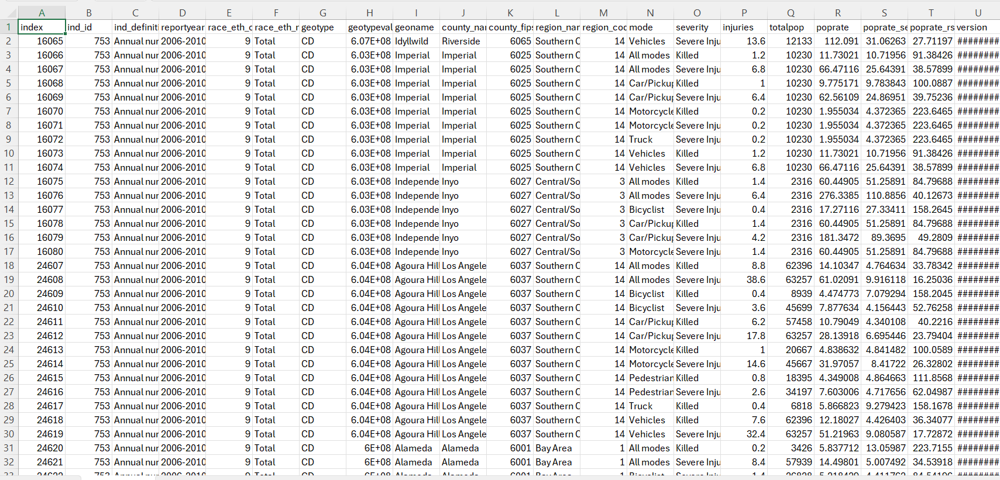
Normalizing dataset!
Raw data is in denormalized form with many missing values, unwanted data.
Efficient dashboard charts requires normalized data.
Python libraries are used to clean the data.
Missing values are replaced with mean and mode values.
Unwanted rows are cleaned and dropped.
Table 1: Cleaned and normalized data

Slide 13
MySQL and Power Bi connector
To connect database to Power Bi following steps are followed,
Defining data source in Pbi
Choosing MySQL connector
Establishing connection using credentials
Selecting the tables from database
Loading data
Data Visualization

Slide 14
BUSINESS INSIGHTS
04
Transforming data into actionable Business insights.

Slide 15
INSIGHTS DRAWN FROM DASHBOARDS
Injuries caused by road accidents are gradually decreasing every year.
Among all providences in California, Los Angeles has more causalities on an average.
Out of all causalities, 1/4th are dead.
Car causes more causalities than other means of transport.
During early nights and late nights, more accidents occur than mornings and afternoons.

Slide 16
PowerBI Dashbord Link

Slide 17
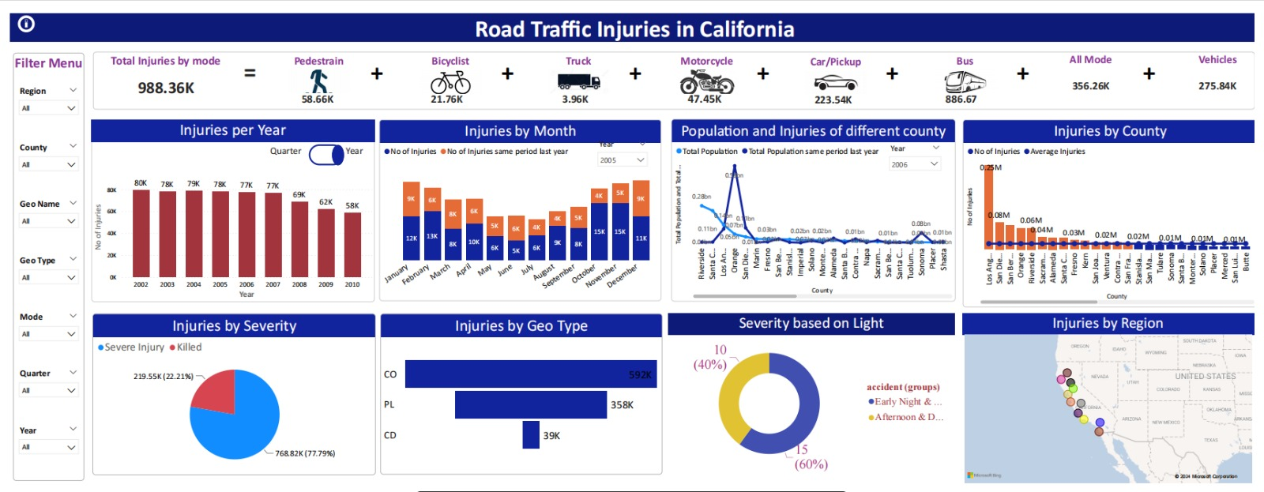

Slide 18
DATA DRIVEN DECISIONS
05
Recommendations for further analysis

Slide 19
Data Driven Decisions
A thorough strategy to improving road safety begins with gathering extensive data on collisions, taking note of variables including location, time, weather, state of the road, and the cars involved.
Statistical and visual aids are used to evaluate this data in order to find patterns and connections that help with the geospatial analysis process of identifying "accident hotspots".
In order to identify contributing variables, root cause analysis explores underlying factors such as driving behavior and road design. By using previous data, predictive modeling forecasts the risk of accidents, allowing for preemptive safety measures.
Intervention strategies are then put into practice, such as enhanced enforcement and improved roads, in accordance with the insights acquired.
By directing continual changes and improving safety precautions, ongoing monitoring and assessment guarantee the effectiveness of these actions.

Slide 20
To reduce road accidents effectively:
Night Driving: Limit non-essential nighttime driving when accidents are most likely to occur. When driving, employ caution, make sure you're well-rested, and utilize your headlights appropriately
Los Angeles Focus: Give priority to safety measures such as increased law enforcement, road improvements, and awareness programs in high-risk locations like Los Angeles.
Recommendations from Data Analysis:
Factors Associated with Night Driving: Examine certain causes of accidents at night, such as poor vision, tired drivers, and alcohol consumption.
Accident Severity: To more effectively prioritize safety precautions, analyze the severity of incidents according to time and location.
Weather Conditions: Use meteorological information to investigate relationships with accident frequencies.
Areas at High Risk: For focused improvements, identify particular road sections or intersections that have a high frequency of accidents.
Demographic Analysis: Look into the likelihood of accidents in various age groups or demographics for targeted education efforts, if the facts allow.

Slide 21
06
CONCLUSION

Slide 22
In conclusion, a thorough strategy is required to lower traffic-related injuries in California.
We can successfully adopt specialized safety measures by concentrating on high-accident regions like Los Angeles and risky hours like night driving.
It is crucial to implement tactics like more law enforcement, improved roads, and awareness programs.
To further improve these measurements, a detailed analysis of factors such as weather, road locations, and driver demographics would be necessary.
By adopting these methods, we aim to make California's roads safer and reduce injuries from accidents.

Slide 23

THANK YOU

